Slide 1
Priority Queues
Presentation for use with the textbook Data Structures and Algorithms in Java, 6th edition, by M. T. Goodrich, R. Tamassia, and M. H. Goldwasser, Wiley, 2014

Slide 2
Priority Queue Abstract Data Type
9.1

Slide 3
Priorities
We studied Queues in Chapter 6
FIFO = First-In, First-Out
For many applications, we should have a queue with some sort of priority
In order of importance or urgency
Other priority based on status (Frequent Flyer)
Pick a choice with the least cost
→ We need a Priority Queue

Slide 4
Priorities
Applications:
(Airline) Standby flyers
Auctions
Stock market

Slide 5
Implementing a Priority Queue with an Unsorted List
9.2.4

Slide 6
Sequence-based Priority Queue 1
Implementation with an unsorted list
Performance:
add takes O(1) time since we can insert the item at the beginning or end of the sequence
remove take O(n) time since we have to traverse the entire sequence to find the smallest key
4
5
2
3
1

Slide 7
Sequence-based Priority Queue 2
Implementation with a sorted list
Performance:
insert or add takes O(n) time since we have to find the place where to insert the item
remove take O(1) time, since the smallest key is at the beginning
1
2
3
4
5

Slide 8
Priority Queue
Comparing running times for operations:
Method | Unsorted | Sorted
size | O(1) | O(1)
isEmpty | O(1) | O(1)
add | O(1) | insert O(n)
remove | O(n) | O(1)

Slide 9
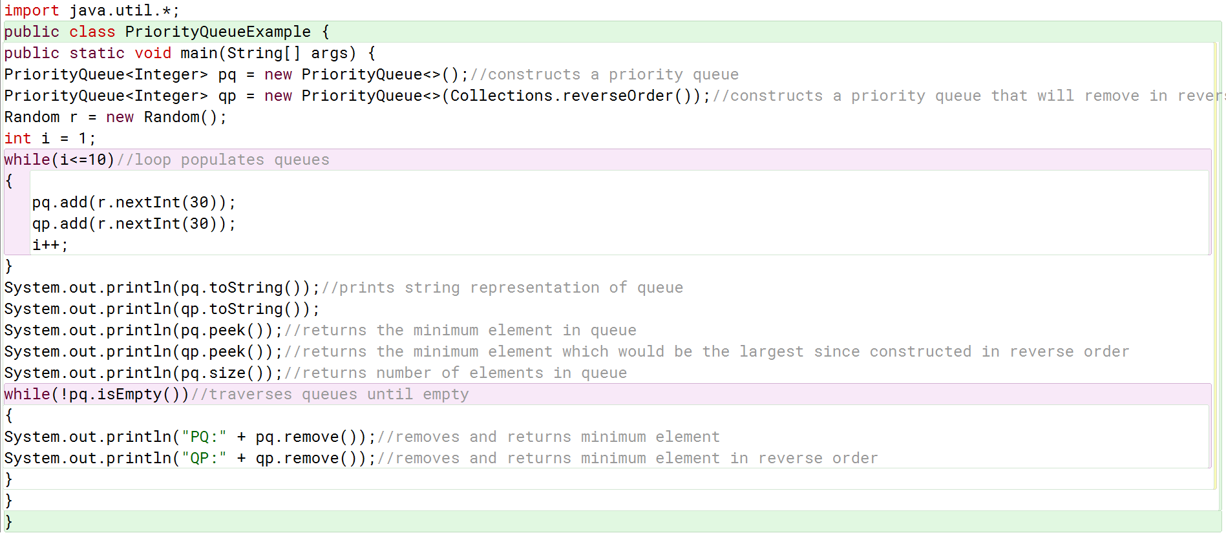
Example

